Slide 1

Adapted and modified from : CS201: Data Structure & Algorithms (Spring 2022) Dr. Cao Tien Dung School of Engineering – Tan Tao University
Network and Graph Introduction

Slide 2
Adapted and modified from : CS201: Data Structure & Algorithms (Spring 2022) Dr. Cao Tien Dung School of Engineering – Tan Tao University
Section1: Graph Introduction

Slide 3
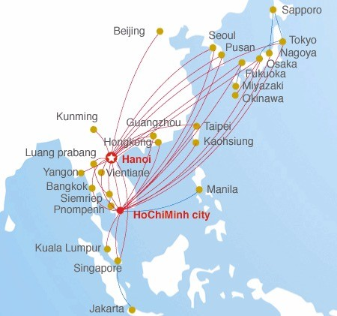

Graphs?

Slide 4
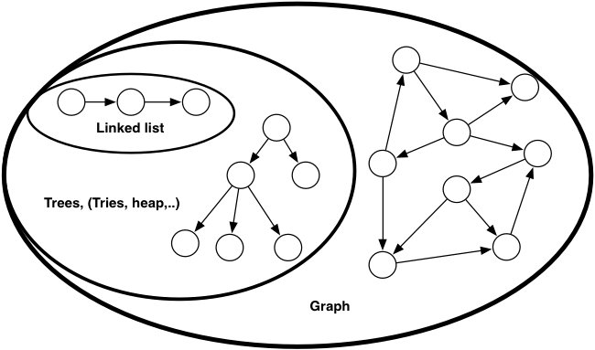
Graphs

Slide 5
Graphs
A graph is a set of nodes and edges
nodes aka vertices
edges aka arcs, links
Edges exist between pairs of nodes
if nodes x and y share an edge, they are adjacent
Edges may have weights associated with them
Edges may be directed or undirected
Nodes may have labels.

Slide 6
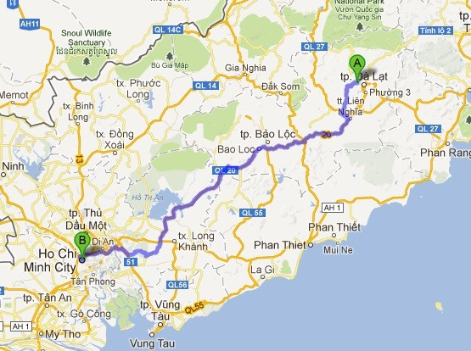
Graph example
Nodes are cities: HCM, Dalat, ...
Edges are roads.
Edges have weight: distance 300km,
Undirected

Slide 7
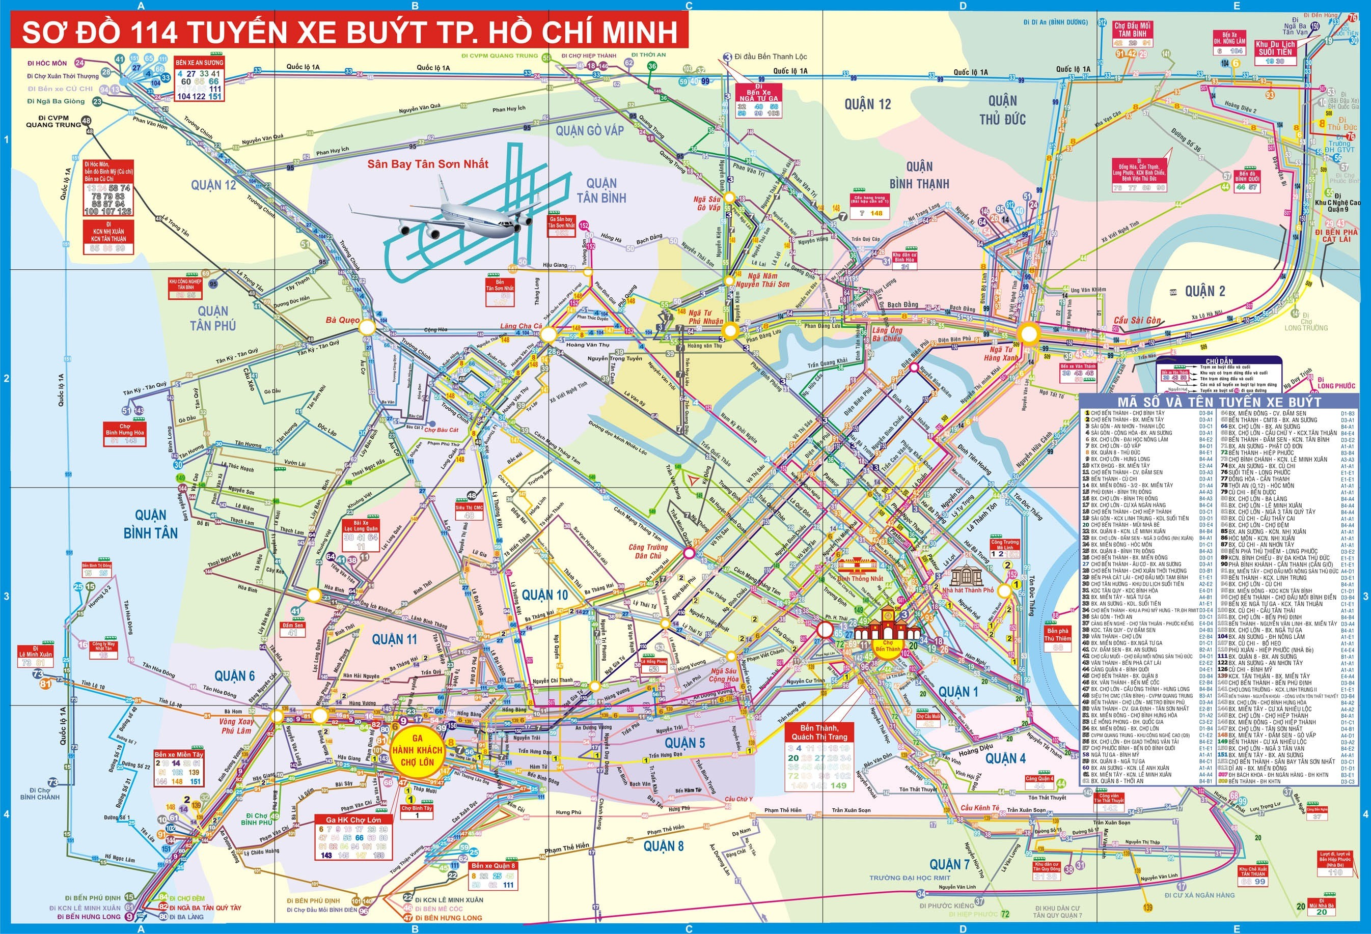
Graph applications
Computer and communication networks
Representing a map as a set of locations with distance.
The World Wide Web
Social networks
Public transportation
Flow Charts
…

Slide 8
Graph properties
A path is a series of adjacent vertices
the length of a path is the sum of the edge weights along the path (1 if unweighted)
A cycle is a path that starts and ends on a node
An undirected graph with no cycles is a (free) tree
A directed graph with no cycles is a special class called a
directed acyclic graph (DAG)
In a connected graph, a path exists between every pair of vertices
A complete graph has an edge between every pair of vertices

Slide 9
Implementation
Option 1:
Store all nodes in an indexed list
Represent edges with adjacency matrix
Option 2:
Explicitly store adjacency lists

Slide 10
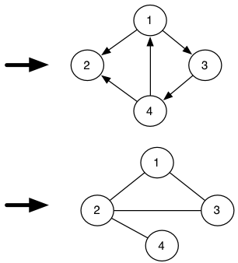
Adjacency Matrices
2D-array A[N][N] of boolean variables, N is node number
A[i][j] is true when node i is adjacent to node j
If graph is undirected, A is symmetric
 | 1 | 2 | 3 | 4
1 | 0 | 1 | 1 | 0
2 | 0 | 0 | 0 | 0
3 | 0 | 0 | 0 | 1
4 | 1 | 1 | 0 | 0
 | 1 | 2 | 3 | 4
1 | 0 | 1 | 1 | 0
2 | 1 | 0 | 1 | 1
3 | 1 | 1 | 0 | 0
4 | 0 | 1 | 0 | 0

Slide 11
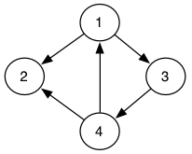
Adjacency Lists
Each node stores references to its neighbors.
How about storage requirement?
1 | 2 | 3
2
3
4
4 | 2 | 1
Notes: For implementation of graph will be conducted in the last section

Slide 12
Adapted and modified from : CS201: Data Structure & Algorithms (Spring 2022) Dr. Cao Tien Dung School of Engineering – Tan Tao University
Section2:Shortest Path

Slide 13
Problem
How to solve this problem?
We have a series of tasks.
we cannot start one task until after its prerequisites are completed.
We wish to organize the tasks into a linear order that allows us to complete them one at a time without violating any prerequisites.
We can model the problem using a DAG?
Directed graph
No cycle

Slide 14
Topological sort
Problem definition:
Given a directed acyclic graph G, order the nodes such that for each edge (v_{i}, v_{j} ) in E, v_{i} is before v_{j} in the ordering.
e.g., scheduling errands when some tasks depend on other tasks being completed.

Slide 15
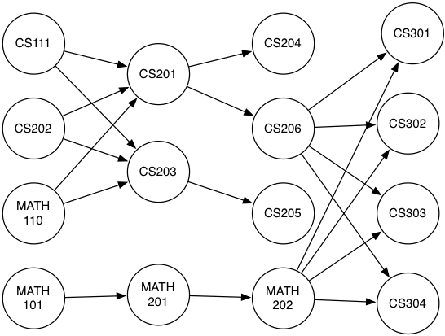
Topological sort example
Course prerequisites structure of CS in TTU

Slide 16
Topological Sort: Algorithm
Compute all in-degrees
Put all in-degree 0 nodes into a Collection
Print and remove a node from Collection
Decrement in-degrees of the node’s neighbors.
If any neighbor has in-degree 0, place in Collection. Go to 3.

Slide 17
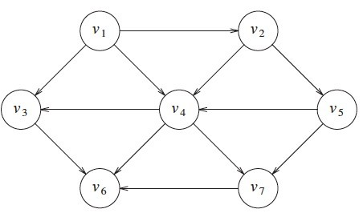
Algorithm example
The ordering is not necessarily unique, any legal ordering will do
V₁ , V₂, V₅, V₄, V₃, V₇, V₆
V₁ , V₂, V₅, V₄, V₇, V₃, V₆

Slide 18
Topological Sort: Running time
Initial in-degree computation: O(|E|)
Unless we update in-degree as we build graph
|V| nodes must be enqueued/dequeued
Dequeue requires operation for outgoing edges
Each edge is used, but never repeated
Total running time O(|V| + |E|)

Slide 19
Shortest Path
Given a weighted graph G = (V, E), and a node s ∈V, find
the shortest (weighted) path from s to every other vertex in G.
Un-weighted graph is a special weighted graph, since we could assign all edges a weight of 1. We can use Breadth-First Search
Motivating example: travel planning
Nodes are junctions, transfer locations
Edge weights are estimated time/distance of travel

Slide 20
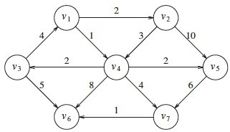
Weighted graph
The problem becomes more difficult when edges have different weights.
Shortest-path from v₁ to v₆ ?
Weights represent different costs on using that edge
Standard algorithm is Dijkstra’s Algorithm

Slide 21
Dijkstra’s Algorithm
Keep distance overestimates D(v) for each node v (starting node is zero, all others are initially infinite).
1. Choose node v with smallest unknown distance
2. Declare that v’s shortest distance is known
3. Update distance estimates for neighbors
Update
For each of v’s neighbors, w,
if min(D(v)+ weight(v,w), D(w))
i.e., update D(w) if the path going through v is cheaper than the best path so far to w

Slide 22

Dijkstra’s Algorithm: example
start
Node | v1 | v2 | v3 | v4 | v5 | v6 | v7
Distance | 0 | ∞ | ∞ | ∞ | ∞ | ∞ | ∞
Known | x | ? | ? | ? | ? | ? | ?
Path | -

Slide 23
Dijkstra’s Algorithm: example
Node | v1 | v2 | v3 | v4 | v5 | v6 | v7
Distance | 0 | 2 | ∞ | 1 | ∞ | ∞ | ∞
Known | x | ? | ? | ? | ? | ? | ?
Path | - | v1 |  | v1
Node | v1 | v2 | v3 | v4 | v5 | v6 | v7
Distance | 0 | 2 | 3 | 1 | 3 | 9 | 5
Known | x | ? | ? | x | ? | ? | ?
Path | - | v1 | v4 | v1 | v4 | v4 | v4
Node | v1 | v2 | v3 | v4 | v5 | v6 | v7
Distance | 0 | 2 | 3 | 1 | 3 | 9 | 5
Known | x | x | ? | x | ? | ? | ?
Path | - | v1 | v4 | v1 | v4 | v4 | v4

Slide 24
Dijkstra’s Algorithm: example
Node | v1 | v2 | v3 | v4 | v5 | v6 | v7
Distance | 0 | 2 | 3 | 1 | 3 | 8 | 5
Known | x | x | x | x | ? | ? | ?
Path | - | v1 | v4 | v1 | v4 | v3 | v4
Node | v1 | v2 | v3 | v4 | v5 | v6 | v7
Distance | 0 | 2 | 3 | 1 | 3 | 8 | 5
Known | x | x | x | x | x | ? | ?
Path | - | v1 | v4 | v1 | v4 | v4 | v4
Node | v1 | v2 | v3 | v4 | v5 | v6 | v7
Distance | 0 | 2 | 3 | 1 | 3 | 6 | 5
Known | x | x | x | x | x | ? | x
Path | - | v1 | v4 | v1 | v4 | v7 | v4

Slide 25
Dijkstra’s Algorithm: example
Node | v1 | v2 | v3 | v4 | v5 | v6 | v7
Distance | 0 | 2 | 3 | 1 | 3 | 6 | 5
Known | x | x | x | x | x | x | x
Path | - | v1 | v4 | v1 | v4 | v7 | v4
Find path: v₆ ← v₇ ← v₄ ← v₁ (length = 6)

Slide 26
Computational Cost
Keep a priority queue of all unknown nodes
Each stage requires a deleteMin, and then some decreaseKeys
(the # of neighbors of node)
We call decreaseKey once per edge, we call deleteMin once per vertex
Both operations are O(log |V|)
Total cost: O(|E| log |V| + |V| log |V|) = O(|E| log |V|)

Slide 27
Adapted and modified from : CS201: Data Structure & Algorithms (Spring 2022) Dr. Cao Tien Dung School of Engineering – Tan Tao University
Section3:Network-Centrality-Measures-and-Their-Visualization

Slide 28
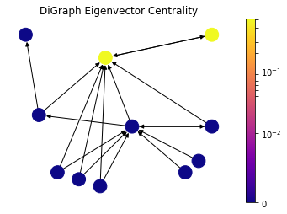
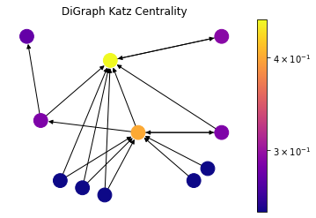
Centrality in Graph
Centrality is a term to describe importance of individual nodes in a graph
How to define which nodes is more important ?

Slide 29
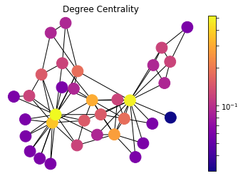
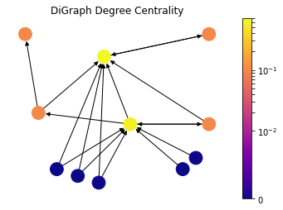
Degree Centrality
Degree of a node is basically the number of edges that it has.
Ex: The person with higher friend count in a social network, the more cited paper (in-degree) in a scientific citation network is the one that is more central according to this metric

Slide 30
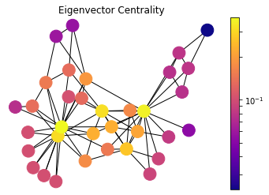
Eigenvector Centrality
Centrality of a node as proportional to its neighbors' importance
Ex: The person with higher friend count in a social network, the more cited paper (in-degree) in a scientific citation network is the one that is more central according to this metric

Slide 31
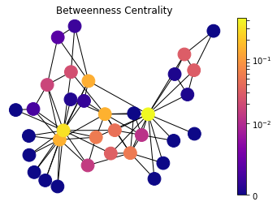
More…
There is still more algorithms to define the important level of a node:
+ Katz Centrality
+ PageRank
+ HITS Hubs and Authorities
+ Closeness Centrality
+ Betweenness Centrality,….

Slide 32
Adapted and modified from : CS201: Data Structure & Algorithms (Spring 2022) Dr. Cao Tien Dung School of Engineering – Tan Tao University
Section 4: Practice

Slide 33
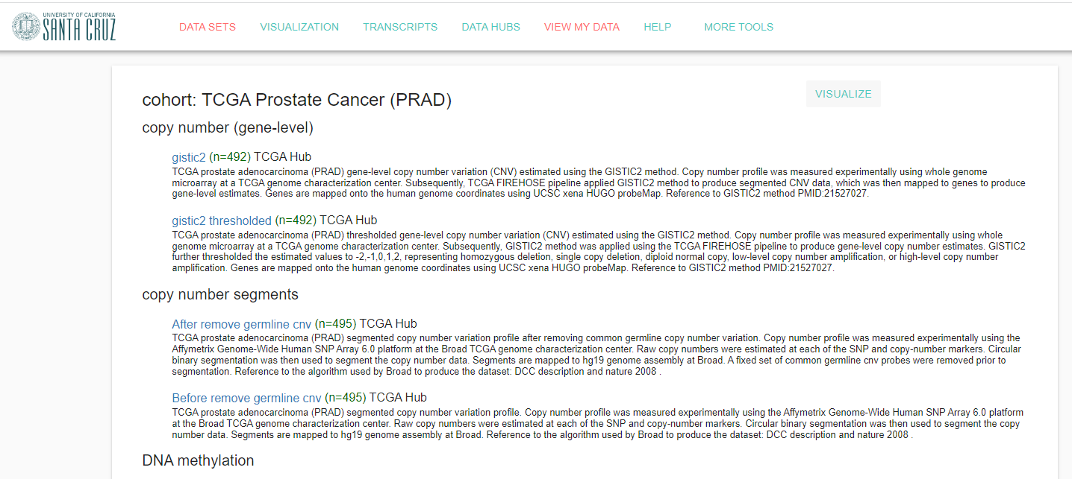
Previous dataset in Machine Learning Course
Follow here:
https://colab.research.google.com/drive/1BuMMku5cZDhAT8KKdQKts5MEw6KNPV3m?usp=sharing
https://xenabrowser.net/datapages/?cohort=TCGA%20Prostate%20Cancer%

Slide 34
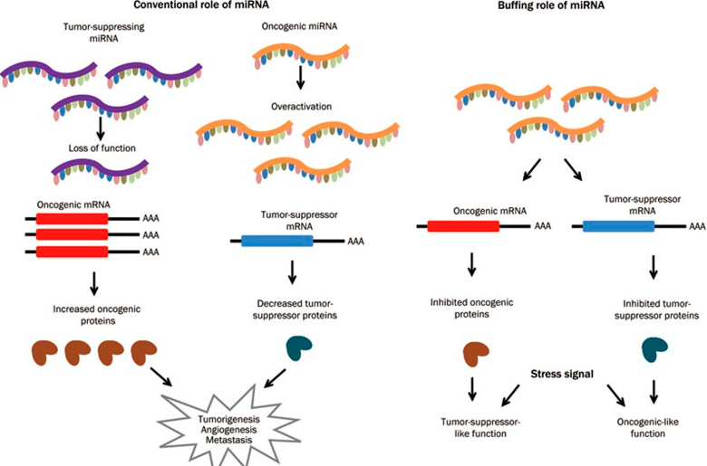
The association between graphs and miRNA ?
https://www.researchgate.net/profile/Haoran-Li-21/publication/236459947/

Slide 35
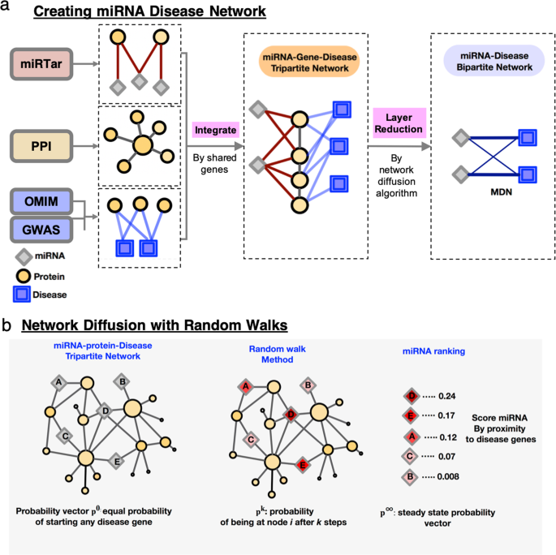
The association between graphs and miRNA ?
Using the correlation coefficient between RNA-seq gene expression level and miRNA expression level to identify the relationship.
For detail: Using gg colab link as below:
https://colab.research.google.com/drive/1BuMMku5cZDhAT8KKdQKts5MEw6KNPV3m?usp=sharing
https://www.nature.com/articles/s41598-020-65633-6

